Slide 1
Stock Market Analysis: S&P500 case study with a statistical paradigm
Othman Mandour

Slide 2
Agenda
Overview of Data and Approach
Market Analysis: Overview Metrics
Visualization Tools Used
Regression Analysis
Central Tendency Analysis
Standard Deviation Analysis
Sample Variance Analysis
Range Analysis
Stock Trends: Apple
Stock Trends: Microsoft
Stock Trends: Tesla
Statistical Analysis for Apple, Msft, Tesla
Regression Analysis for Apple, Msft, Tesla
Conclusion:

Slide 3
Overview of Data and Approach
Data Parameters: Date, Open, High, Low, Close, Adjusted Close, Volume, Percentage Change
1
Summary of Data
2
Approach: Market analysis, visualization tools, regression analysis
3

Slide 4
Summary of Data Parameters
Date
Open
High
When the stock data was recorded.
Initial stock price on the specified date.
Peak stock price during the trading session.

Slide 5
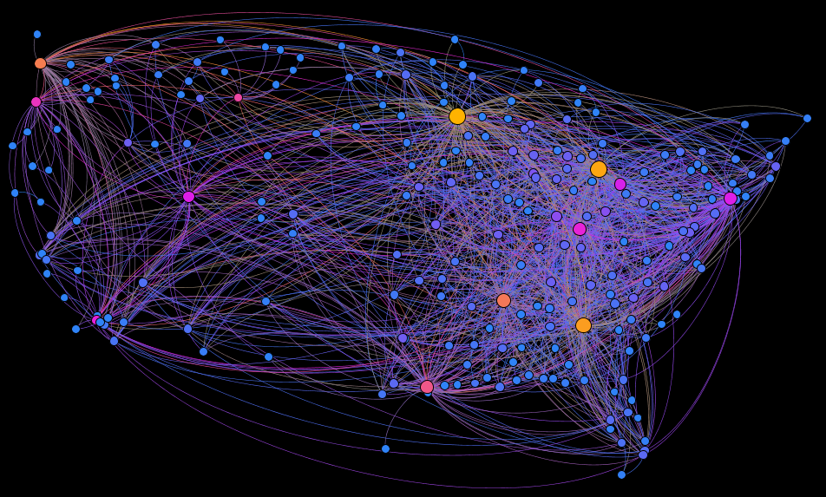
Visualization Tools Used
Visualization Tools
Histograms: Used to visualize the distribution of stock prices and identify any patterns or outliers.
Diagrams: Employed to illustrate the relationships between different variables and their impact on the stock market.
Plots: Utilized to visualize the trends and changes in stock prices over time.

Slide 6
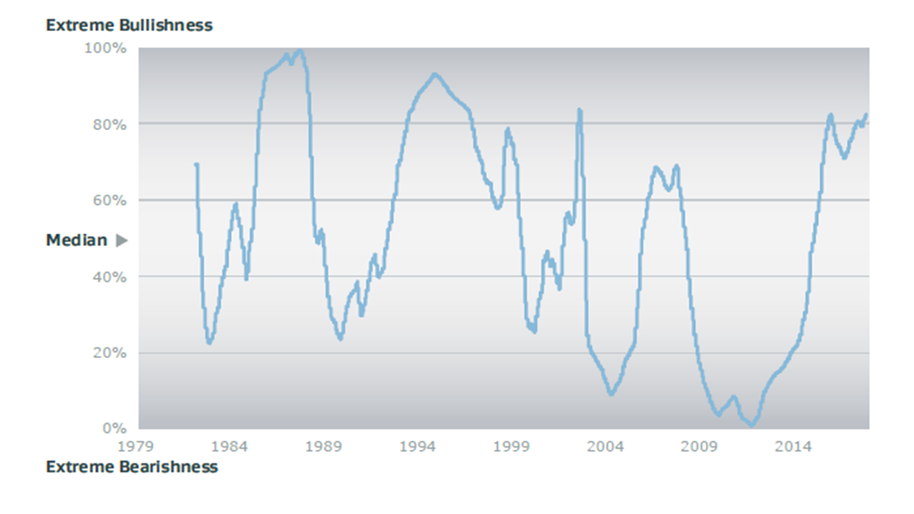
Central Tendency Analysis
Central Tendency Analysis
The median is the preferred central measure due to data skewness.
Skewness is a risk metric when looking at stock market. This metric can help measure the overall trajectory of the data, i.e., bearish or bullish.

Slide 7

Standard Deviation Analysis
Standard Deviation of Stock Prices
Tesla has the highest standard deviation at 116.979, followed by Microsoft at 75.18836, and Apple at 46,19110109.

Slide 8
Sample Variance Analysis
Sample Variance
Tesla Prices: | Close
Mean | 131,7902812
Standard Error | 3,272219195
Median | 97,6400035
Mode | 23,620667
Standard Deviation | 116,9789759
Sample Variance | 13684,08079
Kurtosis | -1,260371058
Skewness | 0,4687922976
Range | 398,038668
Minimum | 11,931333
Maximum | 409,970001
Sum | 168427,9793
Count | 1278
Apple Prices: Close
Mean | 98,64651602
Standard Error | 1,292090365
Median | 95,6150015
Mode | 145,860001
Standard Deviation | 46,19110109
Sample Variance | 2133,61782
Kurtosis | -1,579983416
Skewness | 0,1217838541
Range | 146,462494
Minimum | 35,547501
Maximum | 182,009995
Sum | 126070,2475
Count | 1278
Tesla's stock variation is notably higher than Microsoft and Apple.
Tesla's stock exhibits greater volatility compared to Microsoft and Apple. This means that the price of Tesla's stock experiences more frequent and larger fluctuations over a given period.

Slide 9
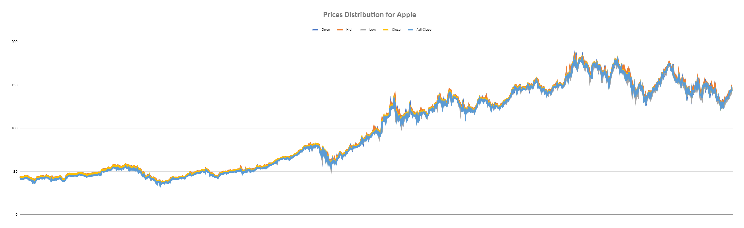
Range Analysis
Stock Price Range
Apple has the smallest price movement range, followed by Microsoft and Tesla.

Slide 10
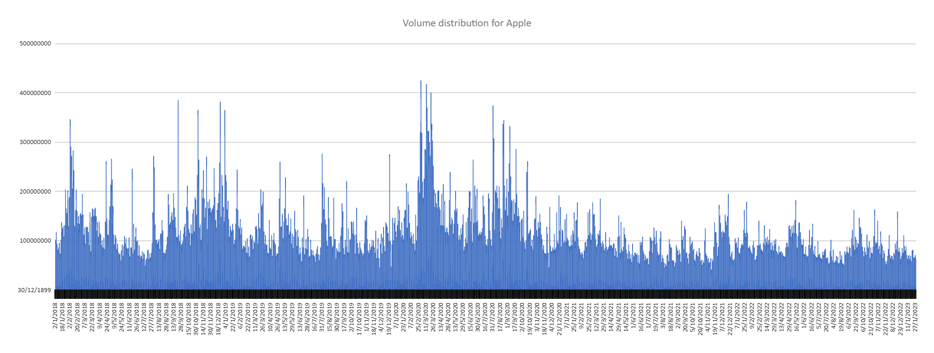
Stock Trends: Apple
Stock Trends: Apple
Key Points
Apple demonstrated consistent growth until an early 2020 decline.
It then resumed its upward trajectory.
Suitable for risk-averse investors.

Slide 11
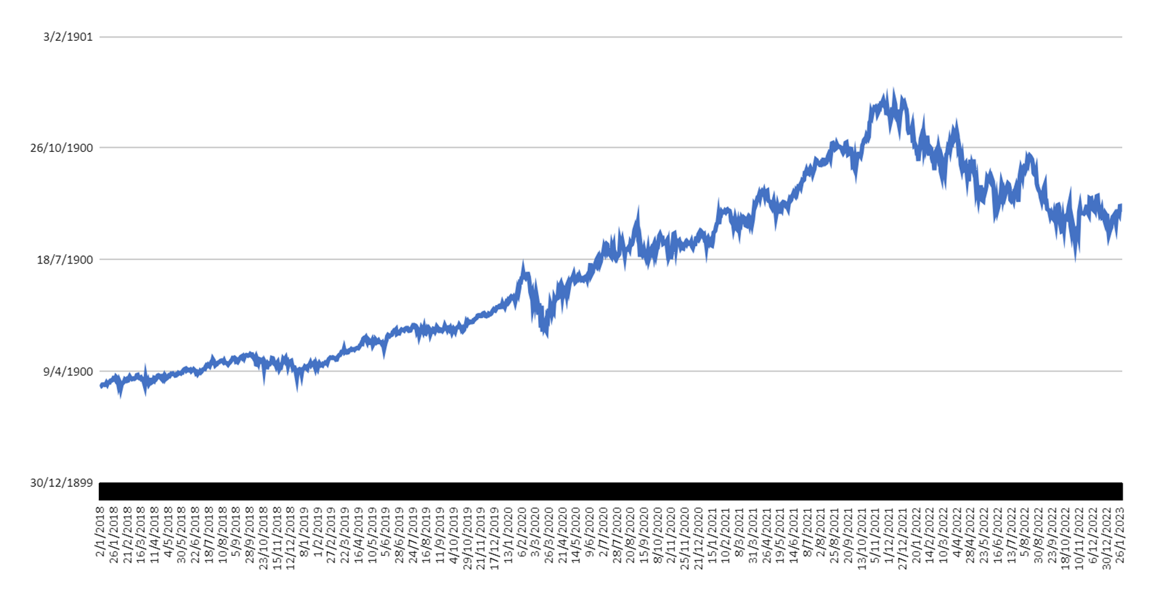
Stock Trends: Microsoft
Key Points:
Stock Trends: Microsoft
Microsoft's stock demonstrated consistent growth with marginally higher risk and returns compared to Apple.

Slide 12
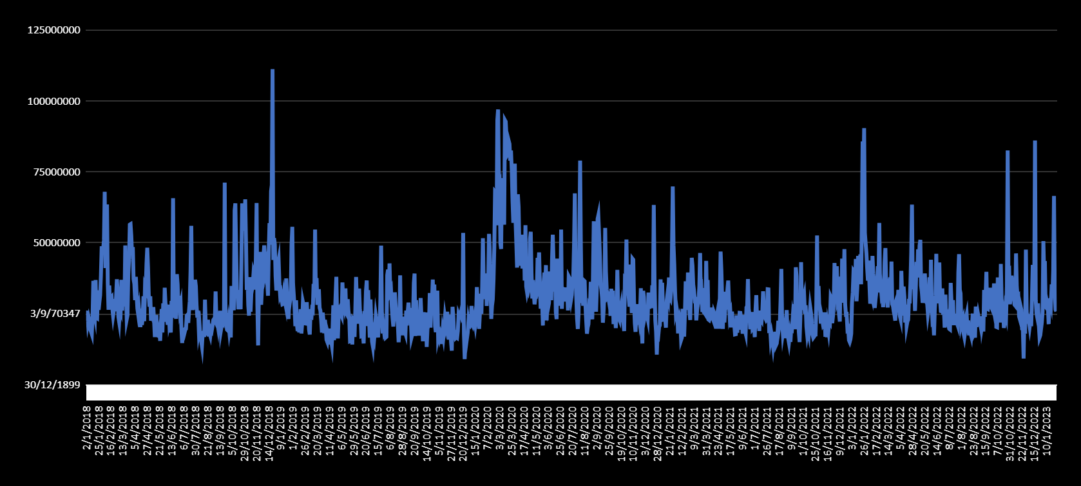
Stock Trends: Microsoft
Key Points:
Stock Trends: Microsoft
Ideal for balancing risk
medium risk for investors
Volume of daily transactions plotted here:

Slide 13
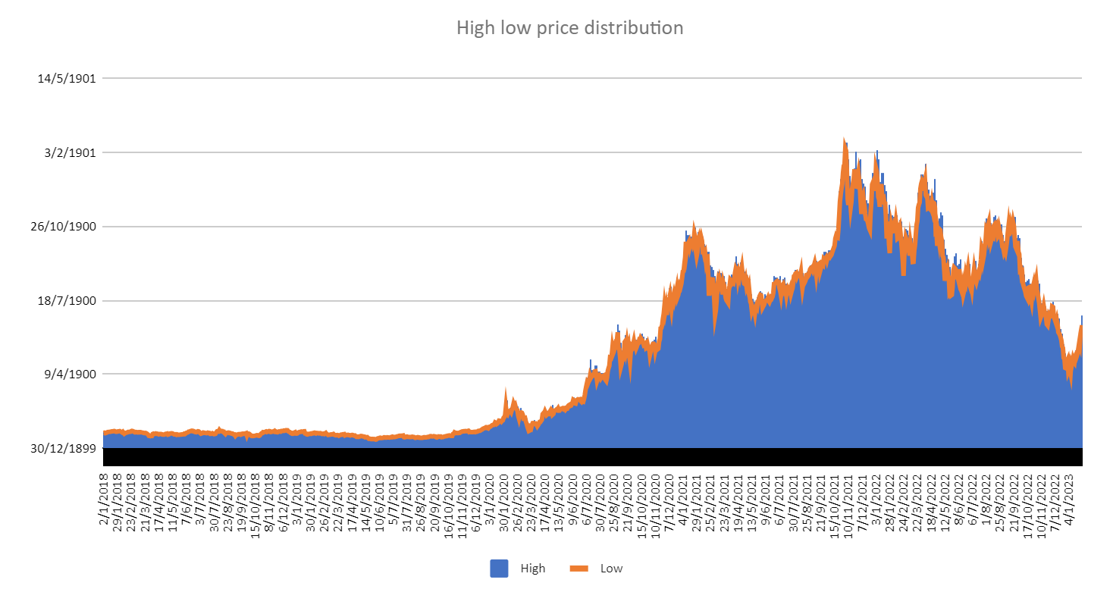
Stock Trends: Tesla
Tesla Stock Trends
Key Observations:
Tesla has exhibited significant volatility in its stock price.
The stock demonstrated consistent growth until an early 2020 decline, followed by a resumption of its upward trajectory.
Tesla is suitable for high-risk investors seeking substantial returns.

Slide 14
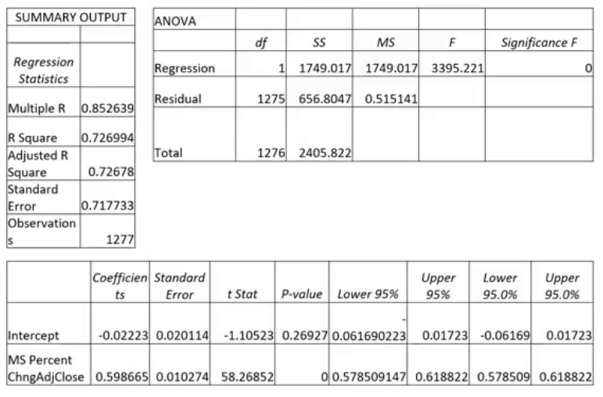
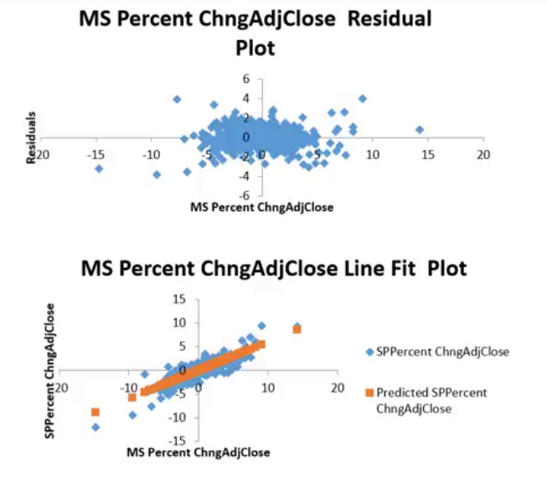
Regression Analysis: Microsoft
Msft%Chng Vs SP500%Chng

Slide 15
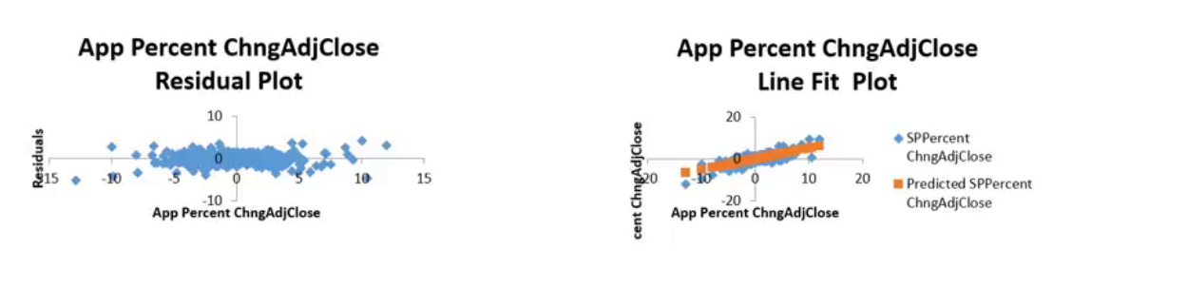
Regression Analysis: Apple
App%Chng Vs SP500%Chng

Slide 16
Statistical Analysis for Apple
0.801856
0.642973
2E-287
Multiple R
Adjusted R Square
Significance F

Slide 17
Regression Analysis for Apple
0.8019
0.6430
0.6427
2E-287‘
Multiple R
R Square
Adjusted R Square
P value

Slide 18
Statistical Analysis for Microsoft
0.478
0.6427
6.09742E-74
Multiple R
Adjusted R Square
Significance F

Slide 19
Regression Analysis for Microsoft
0.8019
0.6430
0.6427
1.9569E-287
Multiple R
R Square
Adjusted R Square
P value

Slide 20
Statistical Analysis for Tesla
0.478
0.228
6.09742E-74
Multiple R
Adjusted R Square
Significance F

Slide 21
Regression Analysis for Tesla
0.478
0.228
0.228
6.09742E-74
Multiple R
R Square
Adjusted R Square
P value

Slide 22

Conclusion: Tesla
Key Takeaways
Tesla exhibits significant volatility, making it suitable for high-risk investors seeking substantial returns.
The correlation coefficient of 0.478 indicates a direct linear association between Tesla's stock and the S&P 500.
Around 22.9% of the S&P 500's variance is attributable to Tesla stock fluctuations.
The regression model shows a robust fit with a virtually zero significance F value.

Slide 23

Conclusion: Apple
Key Points
Apple demonstrated consistent growth until an early 2020 decline and then resumed its upward trajectory.
It is suitable for risk-averse investors.
Apple offers the smallest price movement range among the three stocks analyzed.
Apple's strong brand and loyal customer base contribute to its long-term success.

Slide 24

Conclusion: Microsoft
Conclusion and Recommendation
Microsoft stock has demonstrated a similar trend to Apple, but with slightly higher risk and returns.
It is an ideal investment opportunity for moderate-risk investors looking for a balance between risk and returns.
Based on the statistical analysis, Microsoft stock has a significant influence on the S&P 500.
Investors can consider including Microsoft stock in their portfolio for potential growth and stability.

